Slide 1


Using a Bayesian network meta-analysis to parameterize a cost-utility and value of information analysis of biologics for Moderate-to-Severe Crohn’s disease
Mark Bounthavong, PharmD, PhD
Health Economist
VA Health Economics Resource Center
Stanford University
Beth Devine, PhD, PharmD, MBA
Professor
The Comparative Health Outcomes, Policy, & Economics (CHOICE) Institute
University of Washington
Health Economics Resource Center

Slide 2
Background
Crohn’s disease (CD) -chronic relapsing bowel disease; incidence rate of 7.9 cases per 100,000 (1999-2000) and prevalence of 174 per 100,000 (2001)
Biologics effective for maintaining remission in patients with CD; costs are high ($1,300 to $3,200 per month)
4 FDA approved biologics for the treatment of CD
Motivation: previous cost-effectiveness/utility analyses have not considered these same 4 FDA approved biologics
Baumgart, et al. Lancet 2012;380(9853):1590–605. Kappelman, et al. Dig Dis Sci 2013;58(2):519–25

Slide 3
Objectives and Methods
Conduct Bayesian network meta-analysis (NMA) of FDA approved biologics in treatment of CD
  Infliximab, adalimumab, certolizumab pegol, and vedolizumab
  Comparator = placebo or active control
Use results of NMA to parameterize one transition probability in a Markov model – moderate/severe CD to remission
Use Markov model to estimate the cost-utility of biologics in treatment of CD, from a U.S. payer perspective
Perform value of information analysis to estimate expected costs of uncertainty for not choosing the optimal treatment strategy assuming all (perfect) information were made available
Drummond, et al. Methods for the Economic Evaluation of Health Care Programmes. 4th edition. Oxford University Press, 2015.
Neumann, et al. Cost-Effectiveness in Health and Medicine. 2nd edition. Oxford University Press, 2017.

Slide 4
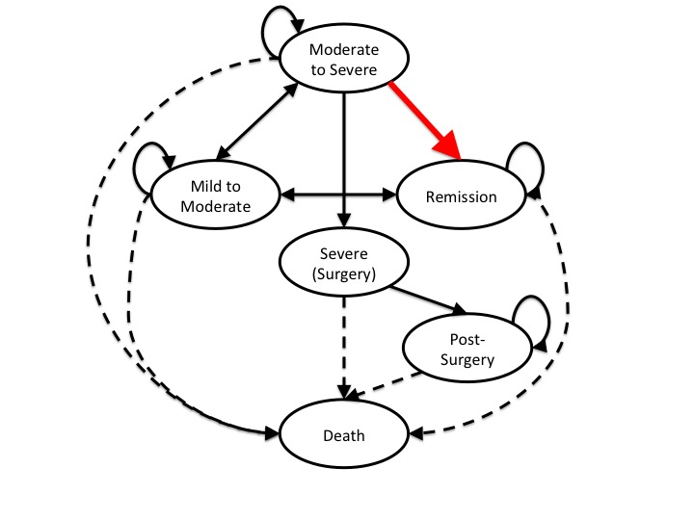
Markov model for Crohn’s disease
Lifetime horizon
3-month cycles
6 transition states
3% annual discount rate
NMA informs this transition probability: Moderate/Severe → Remission
Briggs et al. Decision Modelling for Health Economic Evaluation. Oxford University Press, 2006

Slide 5
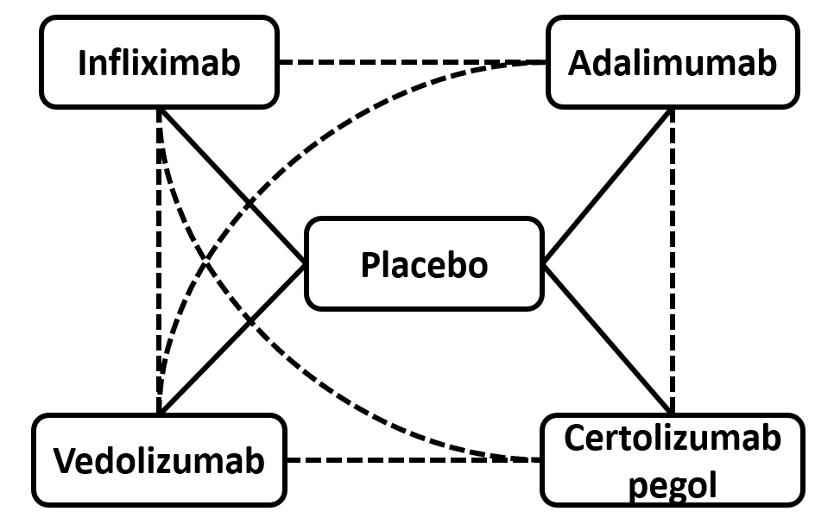
Network meta-analysis (NMA)
9 studies with 5 treatment strategies
  Placebo
  Infliximab (IFX)
  Adalimumab (ADA)
  Certolizumab (CTZ)
  Vedolizumab (VED)
Logit model was used to estimate transition probability from Moderate-to-Severe -> Remission
N=2
N=4
N=1
N=2

Slide 6
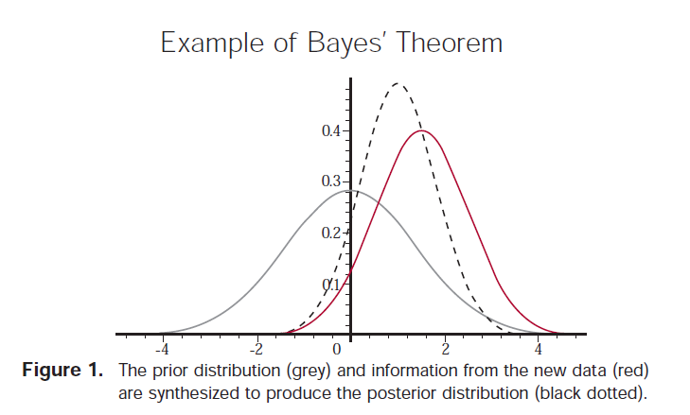
Refresher on Bayesian framework
Advantages of Bayesian framework:
Incorporate prior data
Better estimate uncertainty
Estimate probability of which treatment is best
In context of CUA, preserves relationship among treatment strategies in cost-utility model
O’Hagan & Luce. A Primer on Bayesian Statistics. Center for Bayesian Statistics in Health Economics. MEDTAP International, 2003

Slide 7
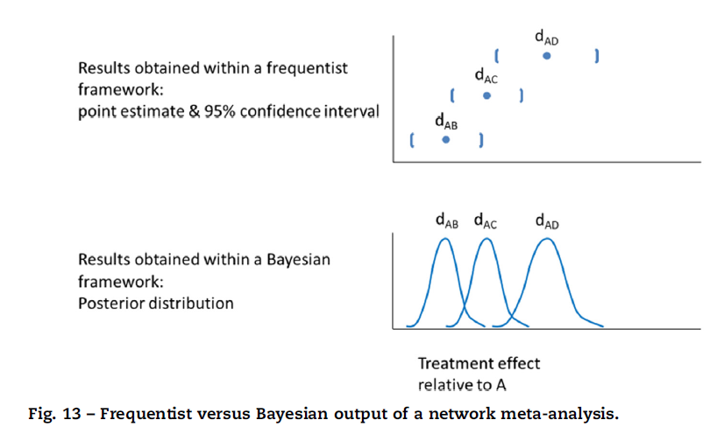
Frequentist vs. Bayesian Results of NMA
Jansen, et al. Value in Health 2014;17:157-173

Slide 8
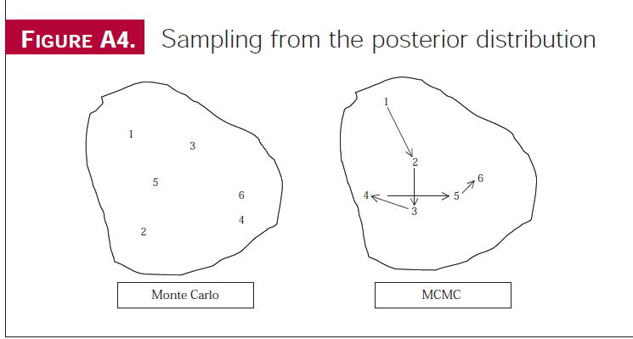
Bayesian Computational Methods –
MCMC versus Monte Carlo Simulation
Cost-utility analysis/
Markov model uses Monte Carlo
NMA uses MCMC
O’Hagan & Luce. A Primer on Bayesian Statistics. Center for Bayesian Statistics in Health Economics. MEDTAP International, 2003

Slide 9
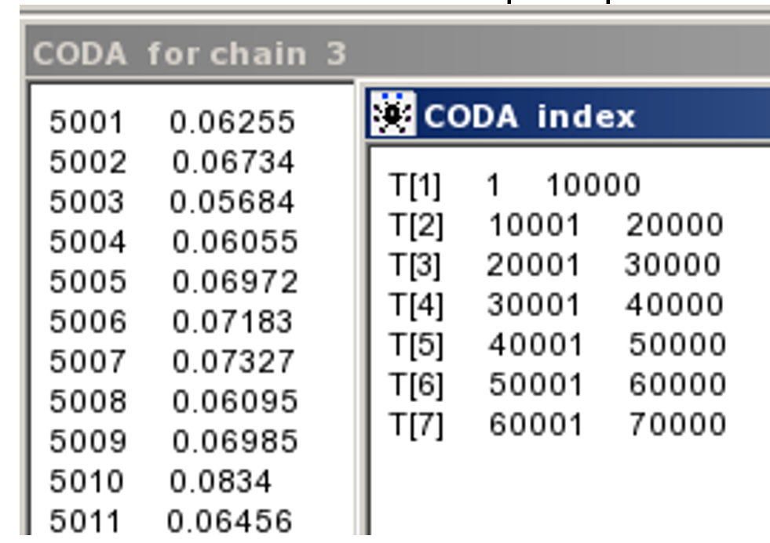
Convergence Diagnostic and Output Analysis (CODA)
Non-informative priors Markov chin Monte Carlo simulation (MCMC)
Gibbs sampler
Three chains
5,000 burn-in simulations
10,000 convergent simulations
T[1]: 1-10000 - iterations for placebo
T[2]: 10001-20000 – iterations for
Infliximab 5 mg
Jansen, et al. Value Health 2011;14(4):417–28; Lumley. Stat Med 2002;21(16):2313-24; Sutton and Abrams. Stat Methods Med Res 2001;10(4)277-303

Slide 10
Results from the NMA
Biologic | Mean Probability of Remission | 95% CrI*
Adalimumab | 0.157 | 0.089, 0.245
Vedolizumab | 0.075 | 0.026, 0.166
Infliximab | 0.119 | 0.056, 0.218
Certolizumab pegol | 0.070 | 0.030, 0.129
Placebo | 0.036 | 0.022, 0.055
*CrI, Credible Interval

Slide 11
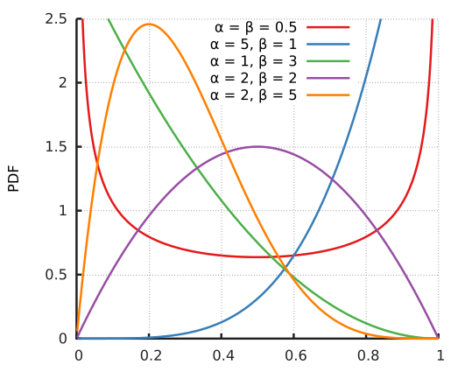

Two methods applying the results of the NMA
Beta Distribution
Table of Transition Probabilities
Cycle | Placebo | ADA | IFX | CTZ | VED
1 | 0.05873 | 0.1429 | 0.1699 | 0.09388 | 0.09002
2 | 0.04317 | 0.1122 | 0.1315 | 0.06804 | 0.07325
3 | 0.04683 | 0.136 | 0.1585 | 0.08832 | 0.08921
4 | 0.03227 | 0.1138 | 0.1051 | 0.06055 | 0.07952
5 | 0.03602 | 0.104 | 0.09945 | 0.07675 | 0.05254
6 | 0.04097 | 0.1636 | 0.1464 | 0.08544 | 0.0493
7 | 0.04126 | 0.132 | 0.1337 | 0.07928 | 0.05578
8 | 0.02895 | 0.09942 | 0.09892 | 0.06536 | 0.06331
9 | 0.02841 | 0.0923 | 0.09753 | 0.05068 | 0.06226
10 | 0.03891 | 0.1527 | 0.1498 | 0.06972 | 0.08972
Second-order Monte Carlo
Go down the list in order for every cycle (N=10,000)
Markov model

Slide 12
CUA Results:
Comparison between traditional beta distribution and Bayesian NMA method
Traditional Beta distribution
Bayesian NMA Method
Strategy | QALYs | Costs
Infliximab | 26.19 | $212,900
Adalimumab | 26.22 | $304,000
Certolizumab | 26.31 | $529,200
Vedolizumab | 26.16 | $249,700
Placebo | 17.70 | $153,000
QALYs
26.22
26.21
26.19
26.20
17.72
Costs
$241,300
$292,400
$393,500
$295,900
$167,800

Slide 13
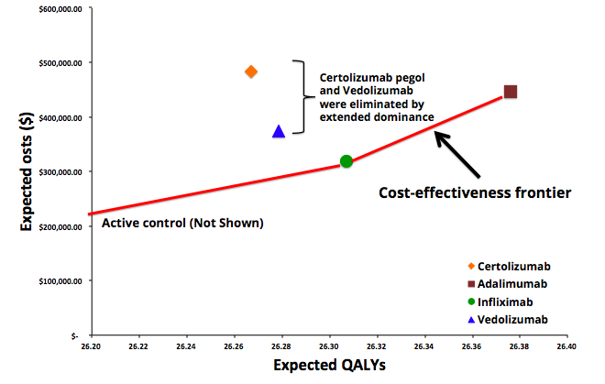
Cost-effectiveness plane
QALY = Quality adjusted life year

Slide 14
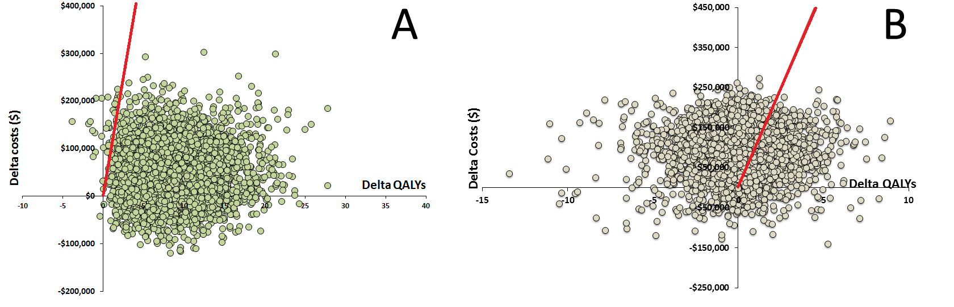
Scatterplot of ICERs comparing infliximab to placebo (A) and adalimumab to infliximab (B).
The red line represents the willingness-to-pay (WTP) threshold of $100,000 per 1-unit QALY gained.

Slide 15
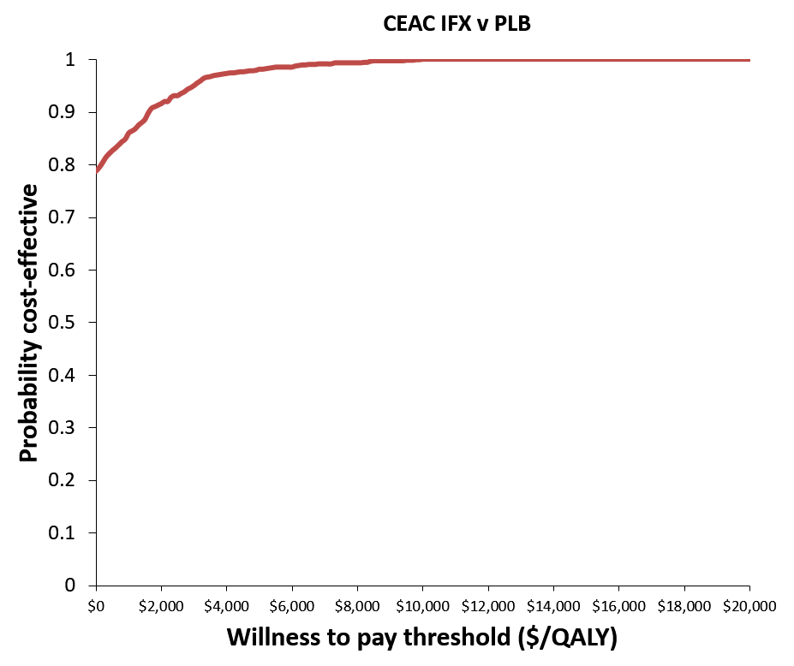
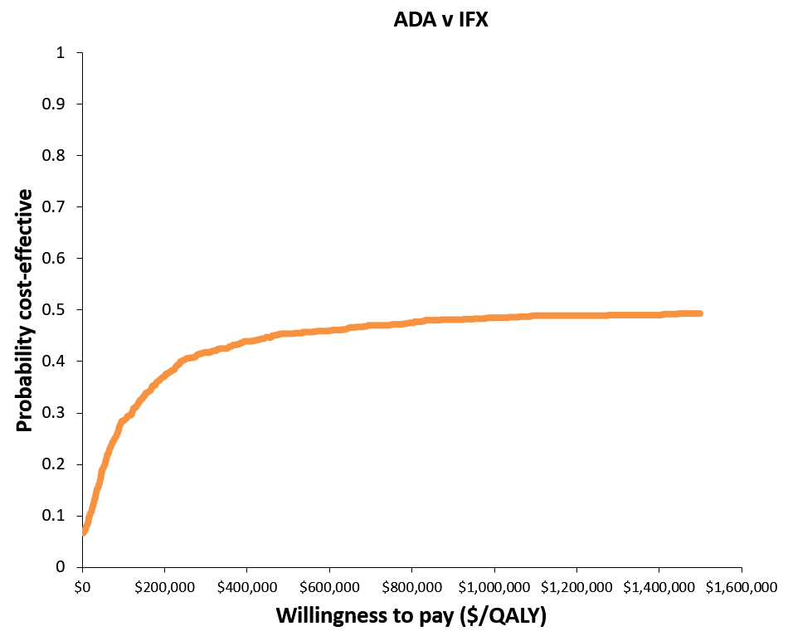
Cost-effectiveness acceptability curve comparing infliximab to placebo (A) and adalimumab to infliximab (B)

Slide 16
Value of Information (VOI)
We performed EVPI using a willingness to pay threshold of $150,000 per additional QALY gained
The affected population was determined with an initial population of 300,000 patients and an annual discount rate of 3%
Population EVPI was determined by multiplying the per-patient EVPI by the affected population
EVPI was evaluated for ten years with the rationale that technology will have advanced beyond biologics in CD treatment and management
Partial EVPI (EVPPI) evaluated the transition probabilities for all treatment arms from the moderate/severe to the remission health states
EVPI, expected value of perfect information

Slide 17
VOI results
Expected value of perfect information (EVPI) and population EVPI results.
Per-patient EVPI ($ USD) | Affected Population* (N) | Population EVPI ($B USD)
$228,662 | 2,008,066 | $459
*Affected population was estimated using an annual prevalence of 300,000 based on the Medical Expenditure Panel Survey with a 3% annual discount rate for ten years.

Slide 18
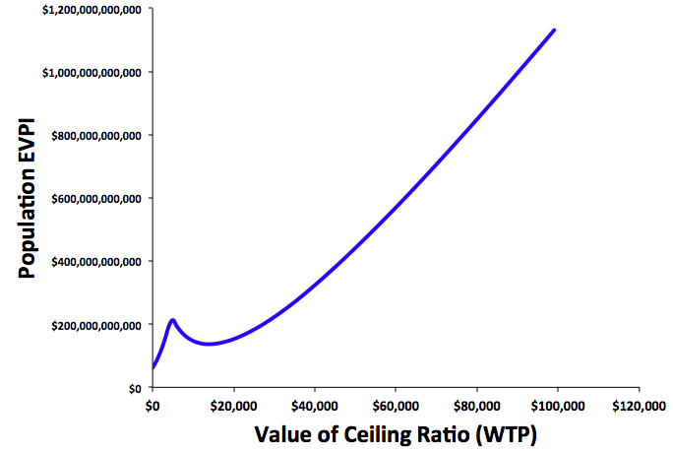
Population expected value of perfect information for all 3 strategies
Peak at $4,570 per QALY gained indicates the incremental cost effectiveness ratio (ICER) comparing infliximab versus placebo.
The population EVPI curve continues because it is estimating the value associated with acquiring information comparing adalimumab versus infliximab, which has an ICER of $2.1 million per QALY gained.
$4,570 per QALY gained

Slide 19
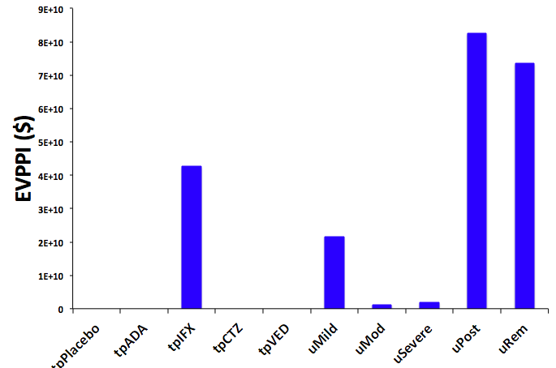
Partial expected value of perfect information (EVPPI)
Reducing the uncertainty in the transition probability for IFX was valued at ~$42 Billion.
Similarly, reducing the uncertainty in the utility values yield high value.
Future studies should attempt to reduce the uncertainty in these parameters.

Slide 20
Limitations/Future Work
Work in progress
Add newer biologics and biosimilars to network
More accurately characterize RCTs with differing randomization schemas
Focus closely on placebo response in infliximab studies, which may have caused bias
Migrate both NMA and CUA to R platform

Slide 21
Conclusions
Indirect comparisons between FDA-approved biologics were possible using NMA (Bayesian)
Results from NMA informed the one parameter (moderate/severe to remission) of the CD Markov model; however, uncertainty surrounding the parameter has an opportunity cost
Population EVPI was $459 billion indicating that it is potentially cost-effective to conduct future research in this area
Reduction in uncertainty of the transition probability for IFX from moderate/severe to remission health state would be of great value
Reducing uncertainty in all utility values would generate greater value in order to avoid making an incorrect decision regarding which strategy to pursue
Future studies should focus on accurately estimating these model parameters

Slide 22
Acknowledgements
Yuna Bae, PharmD, PhC
David J. Vanness, PhD
Anita Afzali, MD, MPH
Rashid Kazerooni, PharmD
David Veenstra, PharmD, PhD
Josh Carlson, PhD

Slide 23

Mark Bounthavong
mark.bounthavong@va.gov
Beth Devine
bdevine@uw.edu

Slide 24
Appendix

Slide 25
Elements of a Network Meta-Analysis
Model
Initial values
Priors
Notes:
Put these in the appendix.
Explain the steps in words.
Visuals to explain the Bayesian process (e.g., Priors, Likelihood function, and Posterior).
Visuals on how MCMC works.

Slide 26
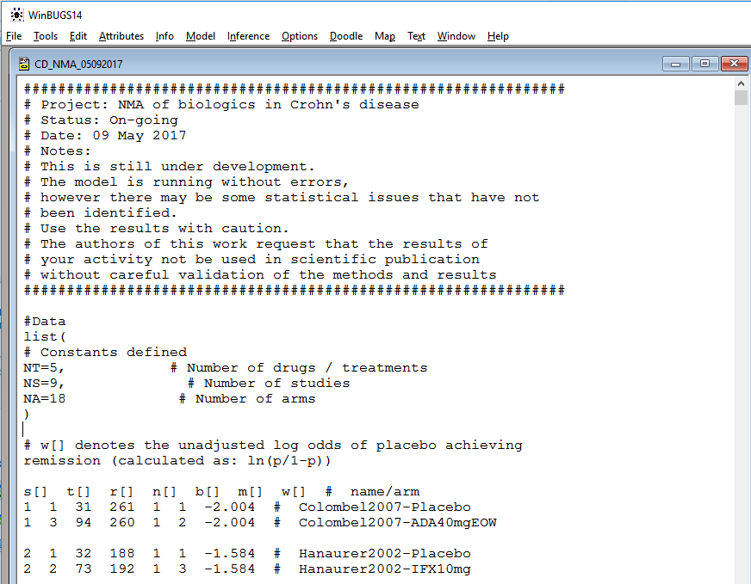
WinBUGS

Slide 27
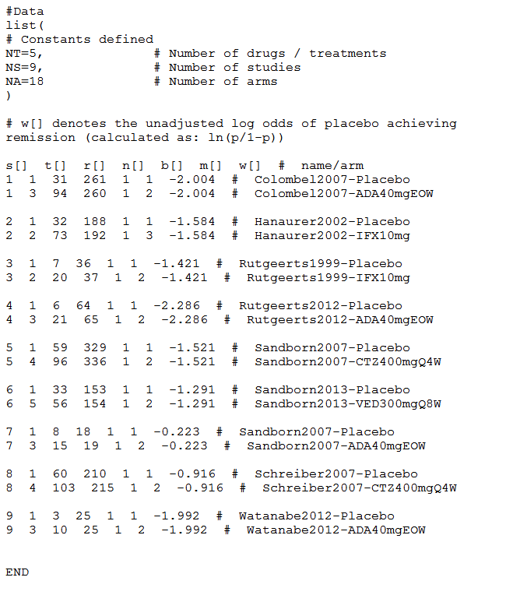
Data

Slide 28
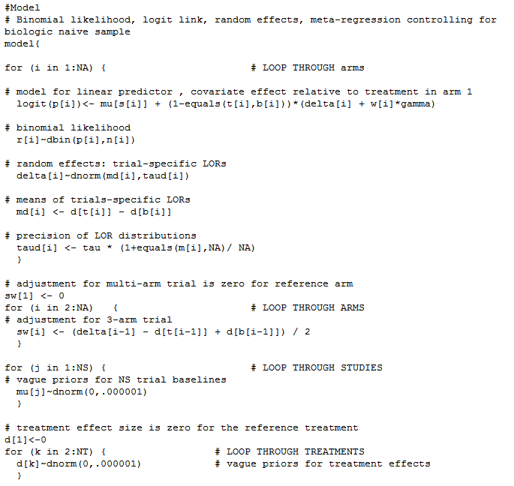
Model

Slide 29
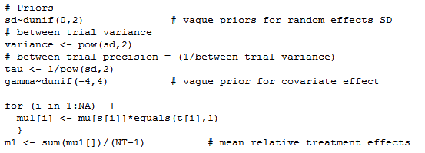
Model (2)

Slide 30
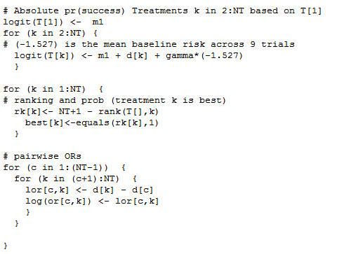
Model (3)

Slide 31
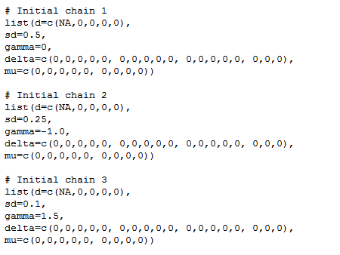
Model (4)

Slide 32
Search criteria
PubMed, EMBASE, and Cochrane Library
Two independent reviewers
Disagreements were handled through consensus
First round (screening): 324 hits
Second round (eligibility): 9 articles included for analysis

Slide 33
PubMed
EMBASE
Cochrane Library
324 articles identified
Identification
293 rejected (title and abstract review):
Not RCT (222)
Did not include outcome of interest (35)
Other reasons (12)
Did not include study drug (9)
Reviews (8)
Pediatric population (6)
Not in Crohn’s disease (1)
Screening
31 full-text articles reviewed
Eligibility
22 rejected
9 articles included for analysis
Included

Slide 34
Details about the EVPPI
Partial EVPI evaluated the transition probabilities for all treatment arms from the moderate/severe to the remission health states. These transition probabilities were generated from the NMA, which was the focus of this study.
In addition, the utility values for the various health states were also investigated in the partial EVPI.
The outer loop used the transition probability from one of the treatment strategies while the inner loop continued with the probabilistic sensitivity analysis for all the other parameters in the model.
A total of 100 outer and 100 inner loops were performed to generate the most efficient estimates of partial EVPI.

